Slide 1



Salesforce Solution for Interview Questions Picker Tool
Jan – 2021
PTG - SFDC
© 2020 YASH Technologies | www.yash.com | Confidential

Slide 2

Agenda
Interview Questions Picker Tool
Purpose
Benefits
Features
Salesforce Edition
Design Architecture
Building Blocks
Demo

Slide 3
Purpose
Yash Salesforce Team has developed Interview Questions Picker Tool which automates the process of preparing a Unique Questions during interview process.
The Interview is a conversation in which you and an employer exchange information. This makes one’s organization Interview Process in a difficult and obsolete the whole concept of repeating the questions to the candidates.
Interviewing is an important step in the employee selection process. If done effectively, the interview enables the employer to determine if an applicant's skills, experience and personality meet the job's requirements.
It also helps the employer assess whether an applicant would likely fit in with the corporate culture.

Slide 4
Benefits
Interviewers can get a unique question from Question Bank.
Panels can categorize questions based on the competency and related topics.
Panels can request number of questions (Easy, Medium, Hard).
Panels Requested Data (Competency, Topic, No of Easy, Medium, Hard Questions and Email) is stored in database for future reference.
Multiple Emails of the Questions are sent from Question Bank as per User Request of Questions (Competency and Related Topic).
Application is available on Salesforce Community which reduces the license cost for the organization.

Slide 5
Features
Track all the Request Questions based on business needs (Related Competency, Topics) by panels.
Sends Questions through emails (User Input by panels) that are requested by panels.
Created public access for community login users (Panels) who can add questions to Question Bank.
Track all the Questions and Answers input by public access through community portal.
Questions and Answers are segregated by competency and related topics.

Slide 6
Salesforce Edition
Salesforce Edition: We offer bundles of features and services, each geared toward specific business needs.
We use a Developer Edition (Spring – 21) which Provides access to the Lightning Platform and APIs. It lets developers extend Salesforce, integrate with other applications, and develop new tools and applications.
Salesforce Licenses: We have used Customer Community User, customer community plus User licenses for the Panels. Business-to-consumer experiences with large numbers of external users who need access to Interview Questions Picker Tool.

Slide 7
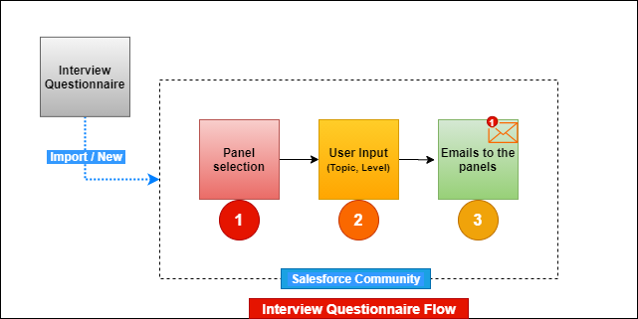
Design Architecture

Slide 8
Building Blocks
Salesforce
Apex Classes
Apex Triggers
Customized Model Popup
Salesforce Lightning Web Component
Salesforce Community
Java Script
Html
CSS
Customized Email Templates

Slide 9
Demo – Interview Question Picker Tool
We have uploaded the Questions data (Excel Sheet) into salesforce org using Data Import Wizard.
Dev Org:
UserName: satyakireet190@cunning-fox-sufnru.com
Password: Kireet@99
Community Link: https://deal-pipeline-comunity-developer-edition.ap16.force.com/iqpt
Panel Login:
UserName: panel@gmail.com
Password: Kireet@99

Slide 10
Demo – Interview Question Picker Tool
In Phase-2 we have developed the following Use Cases:
Handling the request of Multiple Topics Related to Competency at a single time.
With the help of Email Request, User should achieve the functionality of getting the requested questions to that email.
Email to send the request of questions: autoprocess@23a24d0tjhosoztxl8b9w9j57xy8hp845uph8o3maj18v9imfa.2w-6yslaea0.ap16.apex.salesforce.com
Format of Email Body:
Competency:Name_Of_Competency.
Multipletopics:Topics_of_Related_Competency.
NumofEasy:Number_of_Easy_Questions.
NumofMedium:Number_of_Medium_Questions.
NumofHard:Number_of_Hard_Questions.
Email:Email_To_get_the_Requested_Questions!

Slide 11
THANK YOU
Satya Kireet – Trainee
Uttam Singh – Software Engineer

